Slide 1
Our Erasmus
IN POLAND
Peter
Arek
Artur
Mária

Slide 2
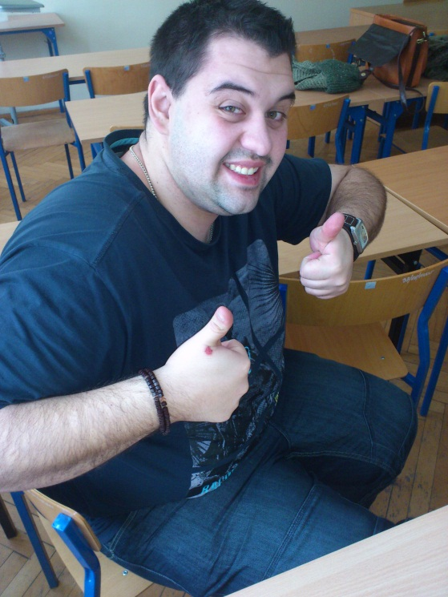
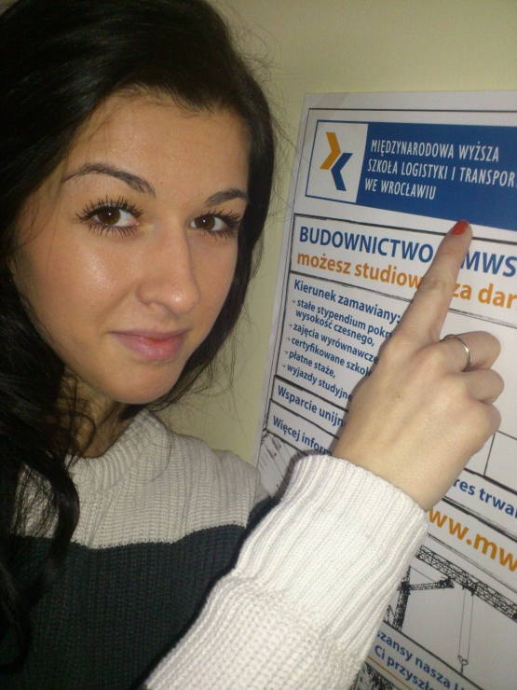
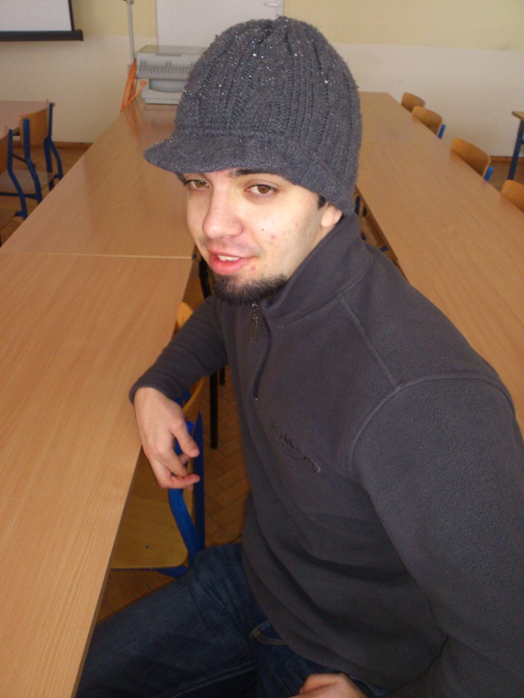
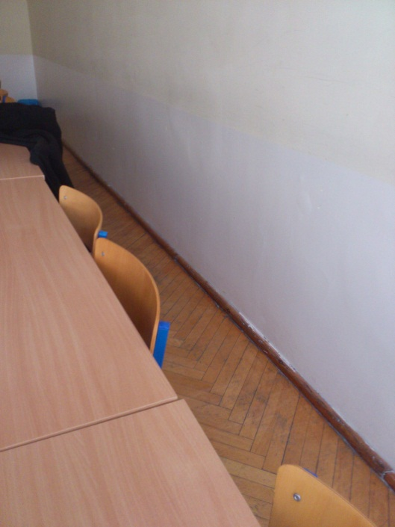
Our „BIG“ GROUP ☺
AREK
PETER
ARTUR
MÁRIA

Slide 3
General overview
1. Why Poland
2. First impressions after arriving
3. What we did on erasmus
4. Our personal experience

Slide 4
Why Poland?
Good intention and motivation
among the private university,
Poland is cheaper than most
other European countries,
good satisfaction among students,
good satisfaction among
academic staff.

Slide 5
Why Poland?
Cultural differences,
historical background,
Poland has a great
geographical location.

Slide 6
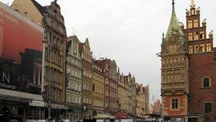
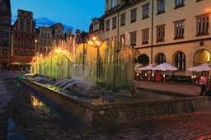
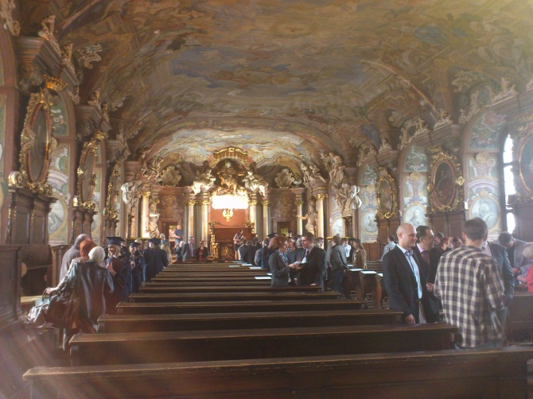
First impressions after arriving
Nice landscape

Slide 7
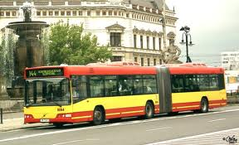
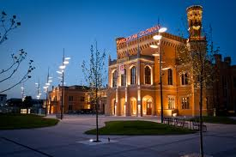
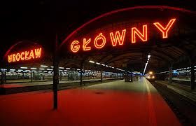
First impressions after arriving
Good infrastructure

Slide 8
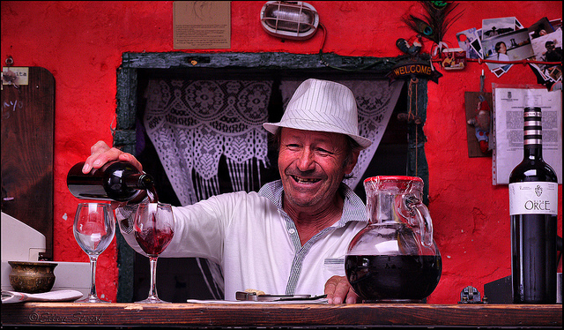
First impressions after arriving
Friendly people

Slide 9
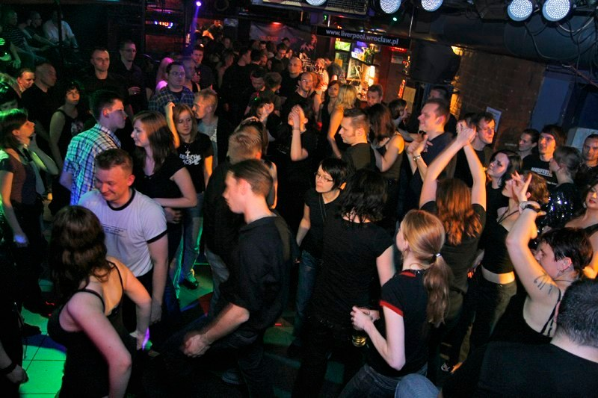
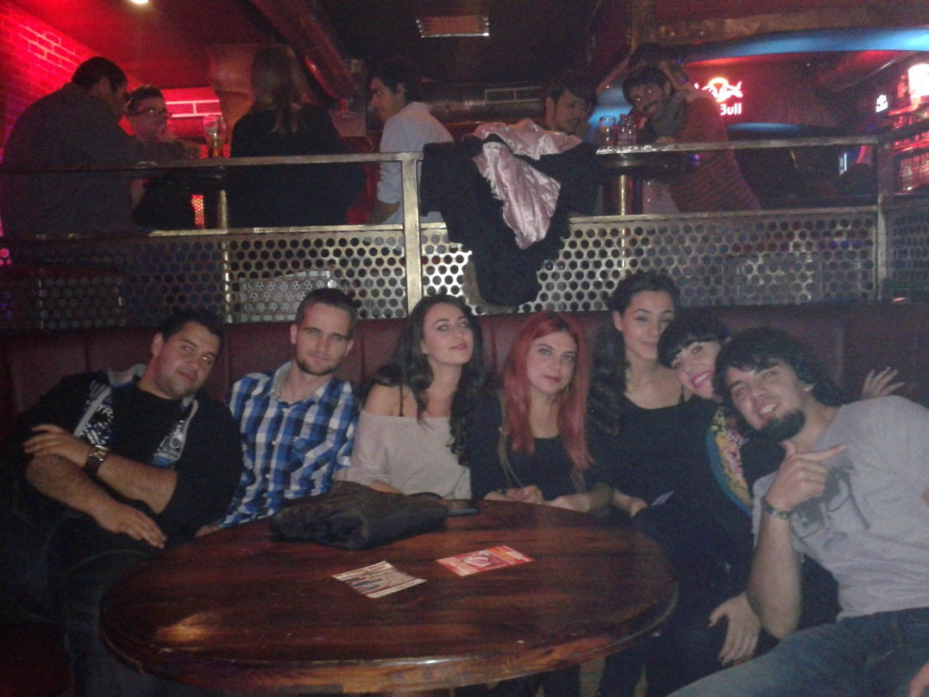
First impressions after arriving
Good clubs

Slide 10
What we did on erasmus
Integration among students
Participation in lessons

Slide 11
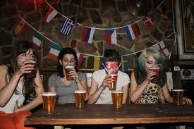
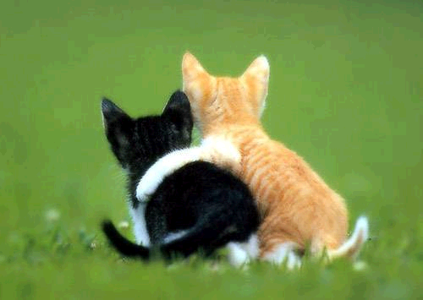
What we did on erasmus
Improving our language skills
New love
To befriend with al lot of students

Slide 12
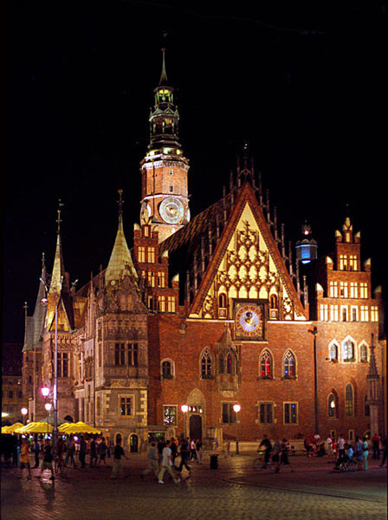
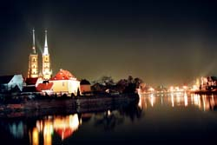
What we did on erasmus
Explore the city and the surrounding

Slide 13
Our personal experiences

Slide 14
experiences
Good university,
young and pleasant professors,
nice city,
likeable people,
new friends,
greater responsibility

Slide 15
Thanks for your attention

